Slide 1
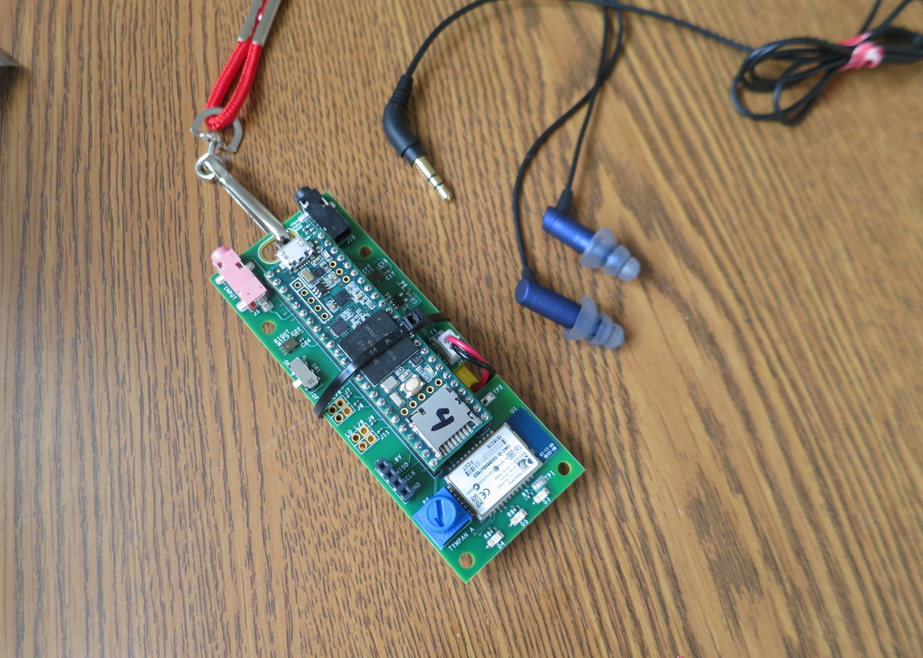
Tympan – Prototype A

Slide 2
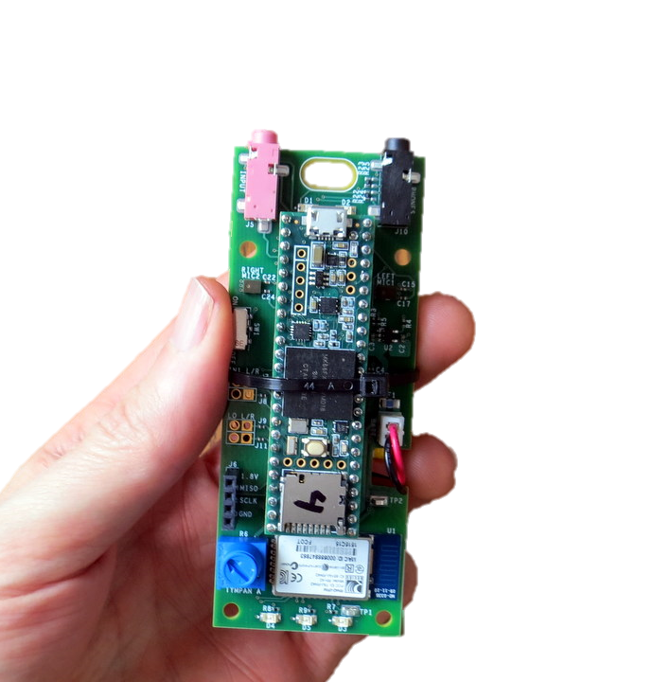
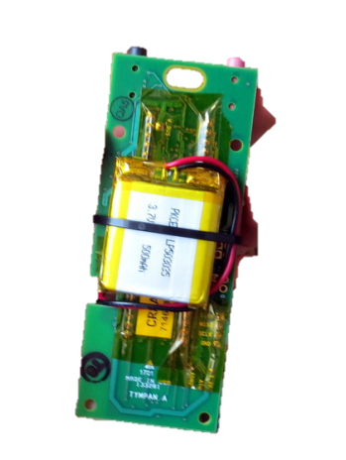
Hardware Elements
USB to
Program/Recharge
Line-In / Mic Jack
Headphone Jack
On-Board Mic
On-Board Mic
Power
Switch
Li-Po Battery on Back
Bluetooth
Classic
User Pot
(Volume)
User
LEDs

Slide 3
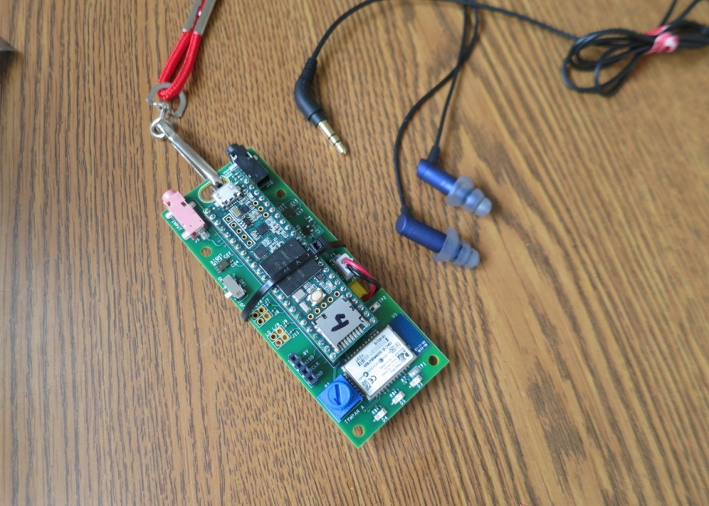
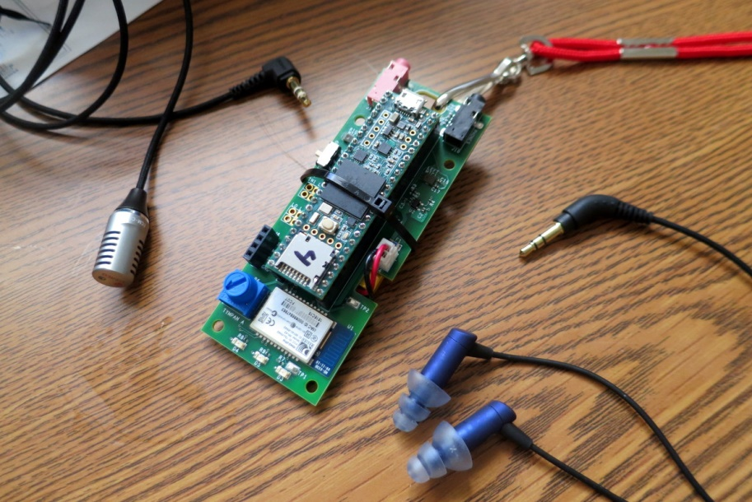
Variety of Inputs
Use On-Board Microphones
Use External Microphone2
Two On-Board MEMS Microphones:
Knowles SPH1642
Stereo Jack for Mics or Line-In.
Software-Selectable Bias Voltage.

Slide 4
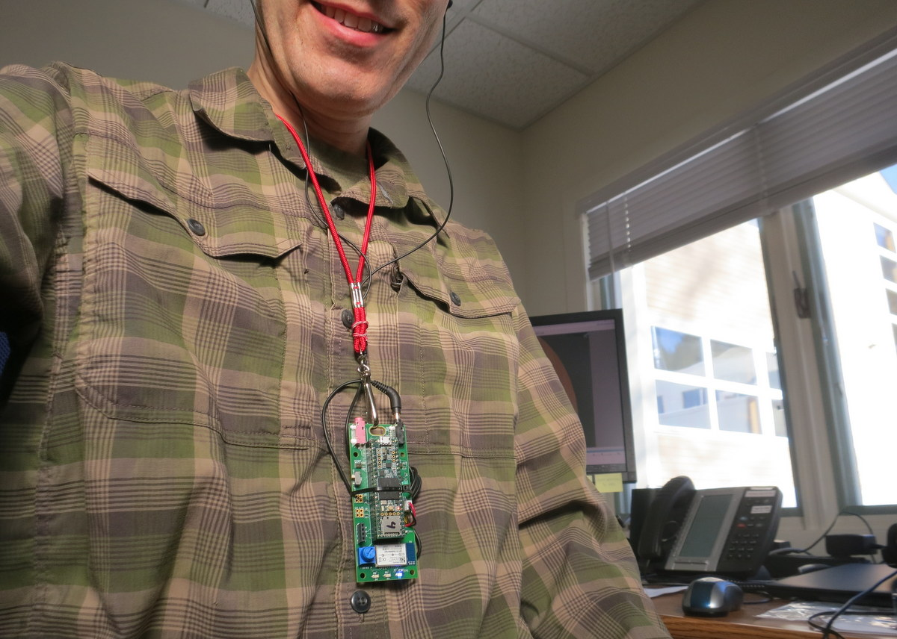
Battery-Powered to Be Wearable

Slide 5
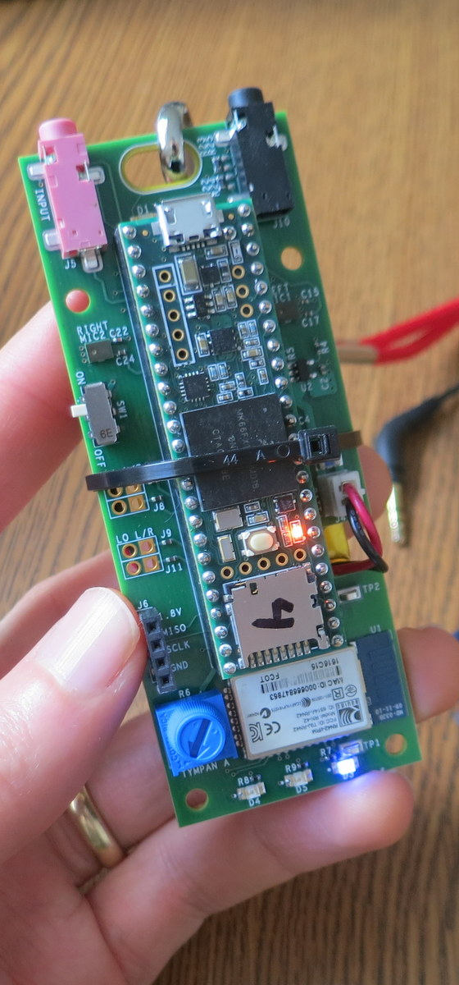
Hardware Specs
Processor
NXP MK66F (ARM Cortex M4F Core)
180 MHz with Floating-Point Unit
Analog-Digital
Texas Instruments TLV320AIC3106, stereo ADC and DAC
32/24/20/16-bit configurable (93 dB SNR)
Low-noise, software-controllable gain on inputs
Software-controllable microphone bias
Software-controllable headphone amplifier
Data Interfaces
USB Serial, USB Audio, USB HID
Bluetooth Classic
SD Card
Digital microphone port
Power
Draws about 100 mA @ 3.7V.
Power from USB or Li-Po Battery
On-board recharging from USB (with indicators)
Programming
Reprogram via USB. Program in C/C++.
Free, open-source toolchain
User Interaction
Potentiometer, LEDs, Bluetooth

